Slide 1
Line Iceberg Display (LID)
USCGA Software Engineering with USCG Research and Development Center
Notes:
Hayden

Slide 2
Recognition
Project Owner Mr. Cline
Advisor Dr. Mraz
Subject Matter Expert Dr. Kessler
Subject Matter Expert Mr. Gold
Developers
2/c Christopher Rosselot
2/c Luke Arsenault
2/c Hayden Carter
2/c Maylis Yepez
2/c Thomas Hardy
Notes:
Hayden

Slide 3
Agenda
Explain the premise
What already exists
How we improved this
Explain our method
How we get the data
What we do to the data
Background on AIS messages
Show the result
Desktop Application
Web Application
Potential Follow-up
Notes:
Luke

Slide 4
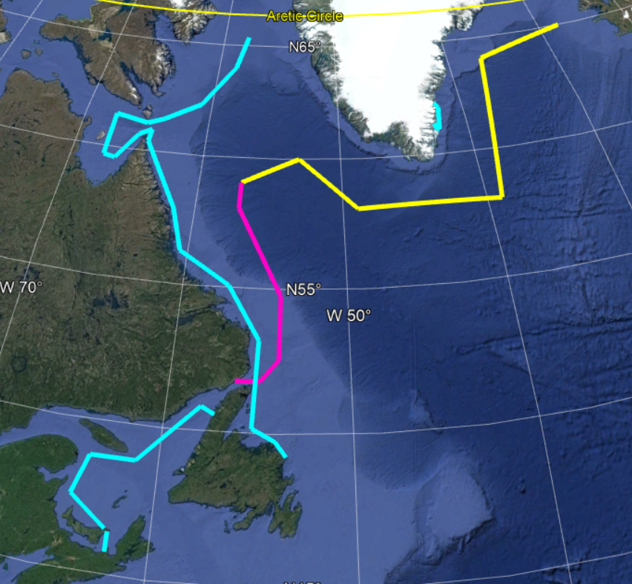
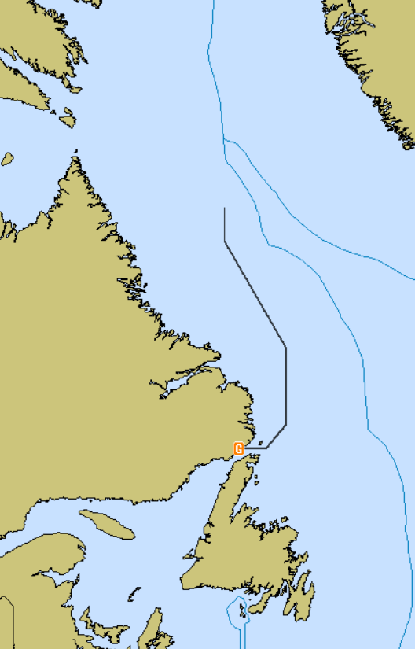
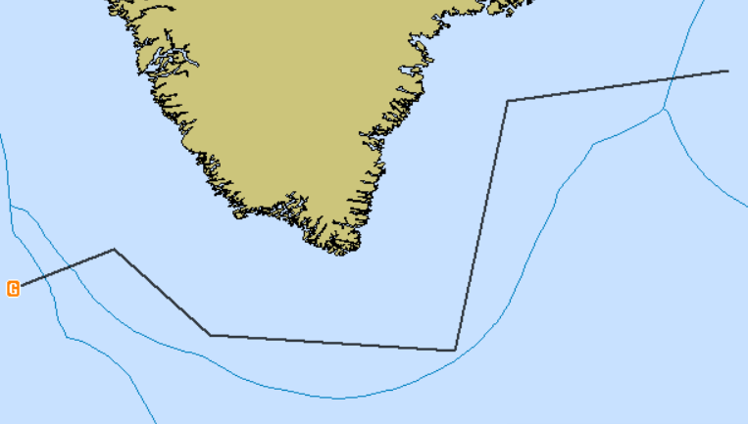
What is it?
L.I.D takes daily information transmitted from the NAIS (North American Ice Service), converts LAT/LONG position of iceberg risk boundaries into a usable format of contour lines which then will be sent out to mariners to be plotted on commercial navigation equipment.
Notes:
Maylis

Slide 5
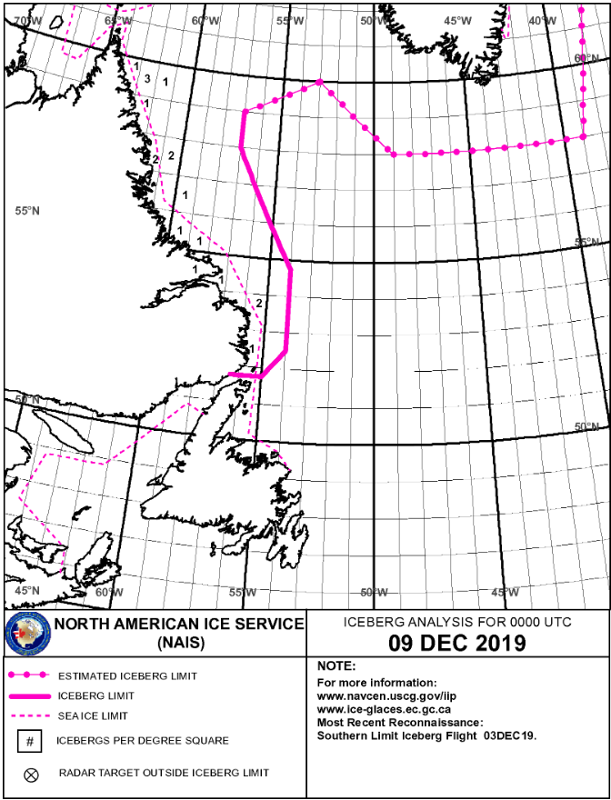
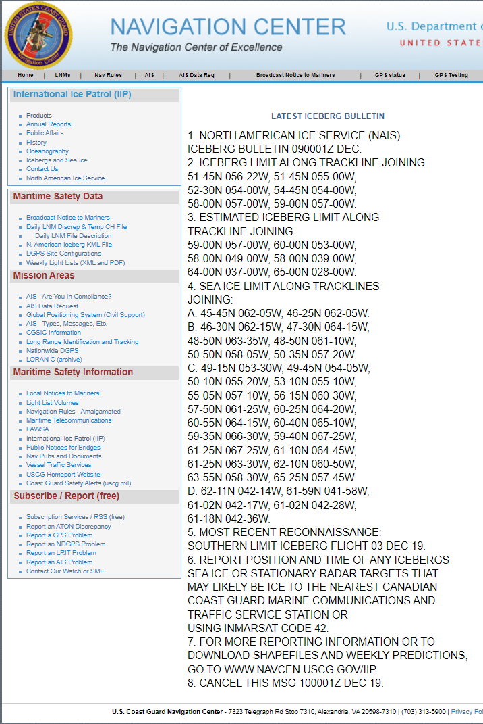
What is provided
Mariners traveling through the zone depicted in the chart rely on a pdf file released daily in order to make informed decisions on the safest route to take
Notes:
Chris
Chart: https://www.navcen.uscg.gov/?Do=popImage&urlRef=images/iip/data/2019/20191211_NAIS65.gif
Bulletin: https://www.navcen.uscg.gov/?pageName=iipB12Out

Slide 6
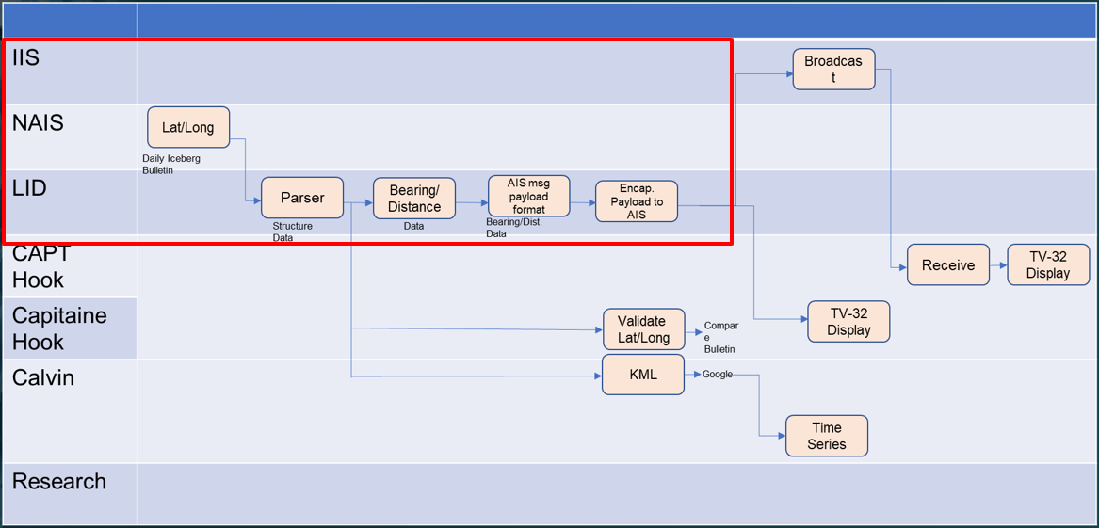
Acceptance Criteria
Create useful data to send to mariners from a daily bulletin.
Notes:
Chris

Slide 7
Features and Capabilities
The name on the left is the group that the feature stems from or benefits. The two Captains represent US and international mariners, and “Calvin” is the project owner.
Notes:
Maylis

Slide 8
What we produced
We were able to create a simple desktop application which allows a user to access daily information without depending on an external service
Google Earth KML files for 'home' use
AIS Message for transmission to mariners
Developed a proof of concept website that demonstrates the possible capabilities that a website using our code could have in making the data easily available
Notes:
Tom

Slide 9
Library of Code Path
Online Bulletin
Download.cs
Bulletin Text File
Scraper.cs
Ingestor.cs
Multiple Text Files
Ingestor Object
Line.cs
BearingRange.cs
Bearing and Range Text File
BinaryCreator.cs
AISMsgMaker.cs
AIS Text File
KML File
Google Earth
Web-App
Binary2ASCII
TV-32
We used an agile development process, allowing us to work in parallel with each other. This is why there are many intermediary ‘classes’ which are used to process the information
Black | Online
Light-Blue | Code (C#)
Light-Green | Class Created Object
Dark-Blue | Text File
Dark-Green | Application
Notes:
Hayden

Slide 10
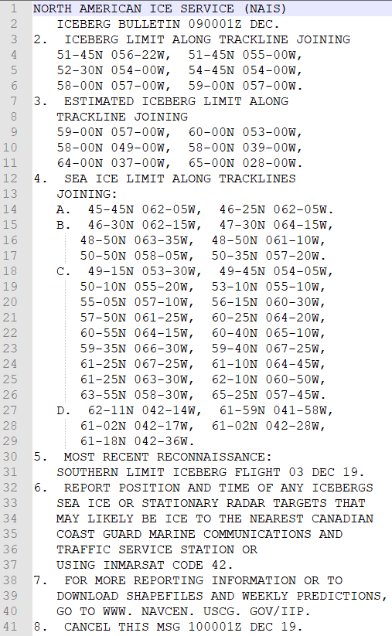
Pulling the Data
Pulls website data off International Ice Patrol Website
Parses out the Bulletin Message
Pass the Bulletin to the other parts of the program
Notes:
Chris

Slide 11
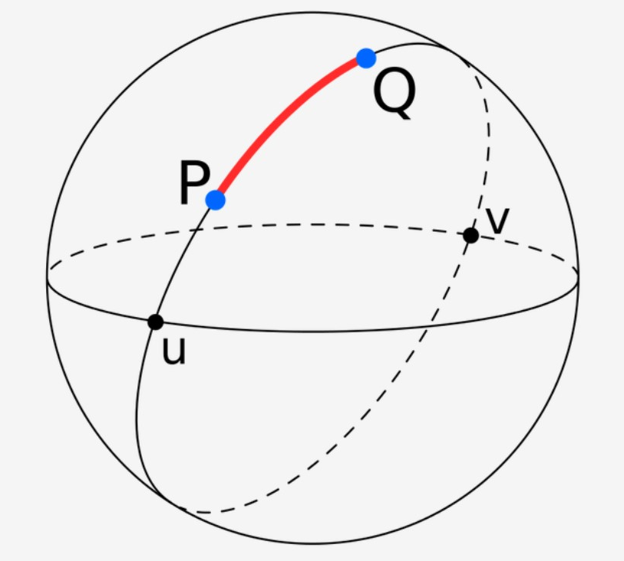
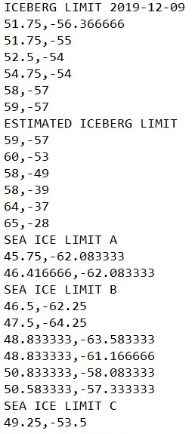
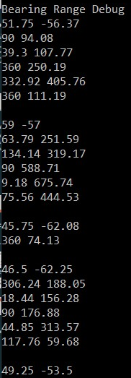
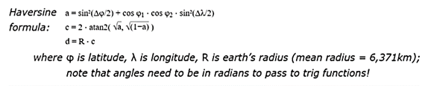
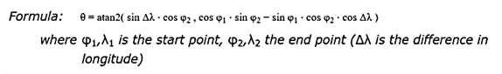
Cartesian to Polar Coordinate Conversion
We view the earth as a great circle and conduct the calculations accordingly
Cartesian Coordinates
Polar Coordinates
Haversine Formula: Finds the great circle distance between two points
Forward Azimuth Formula calculates the initial bearing of a straight line between two points on a great circle arc.
Notes:
Maylis
Formulas : https://www.movable-type.co.uk/scripts/latlong.html
Sphere picture: https://en.wikipedia.org/wiki/Great-circle_distance

Slide 12
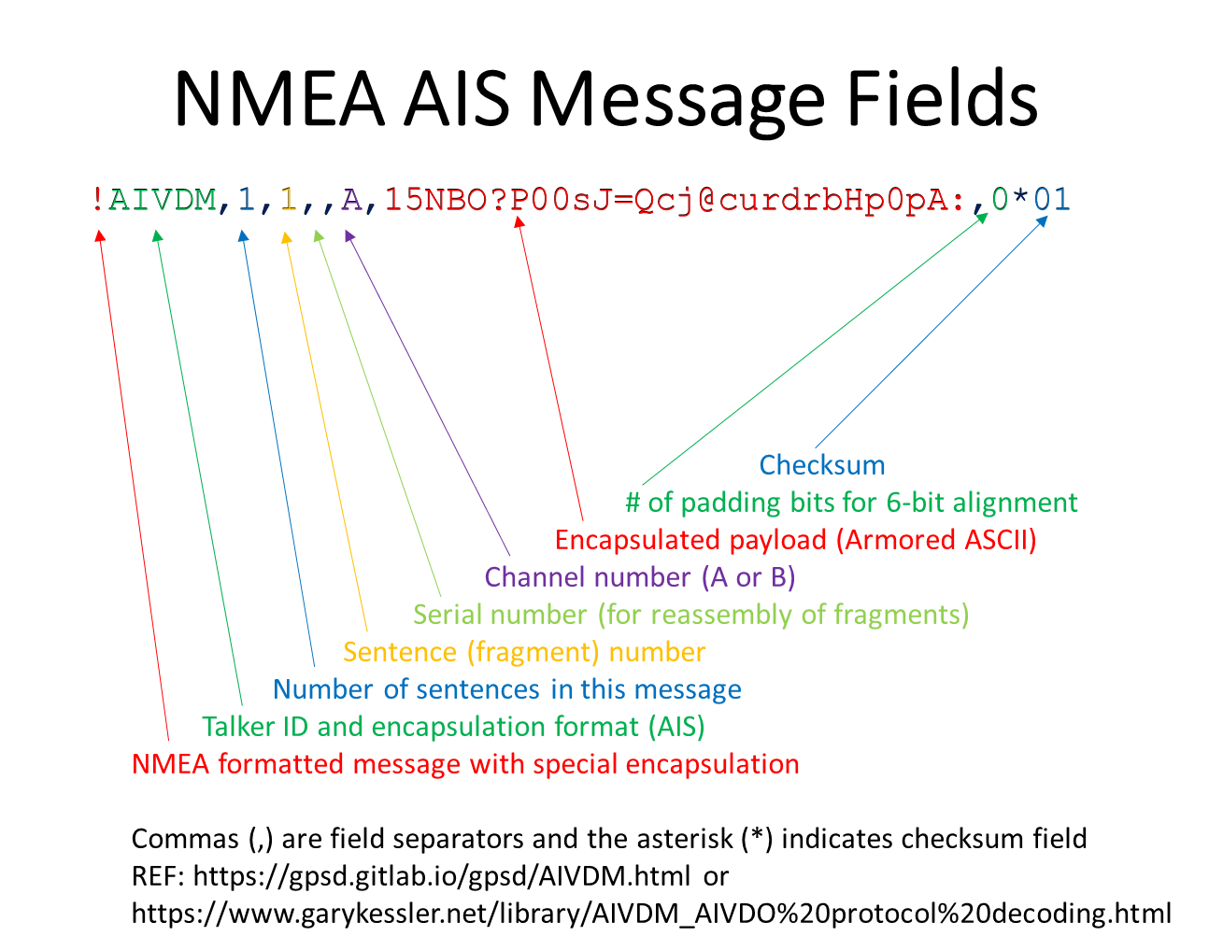
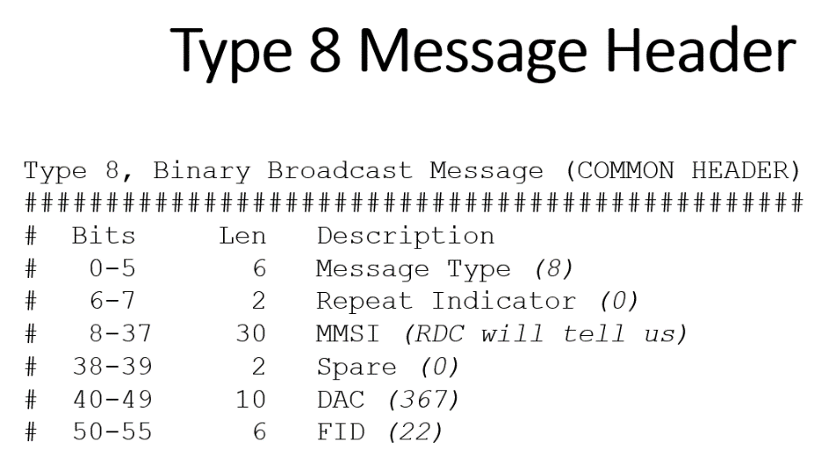
AIS Background
There is a standard for AIS messages that we must follow
First we create the payload for each line, then put together the messages
Dr. Gary C. Kessler, 10/2019
Notes:
Luke

Slide 13
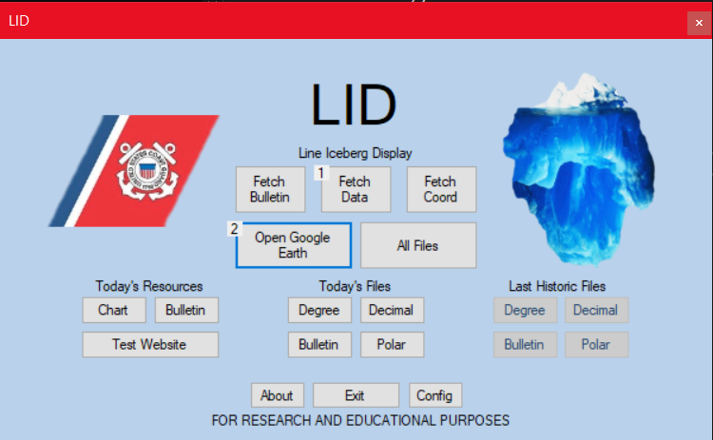
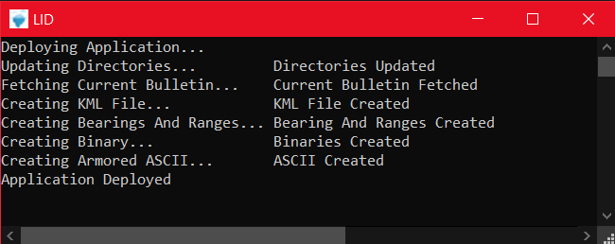
The Application
Interactive GUI with several helpful links and the ability to view generated files for the day
Console component that displays current process and any errors such as not being able to connect to the IIP's bulletin
Configuration for debug mode, allowing for amplified information
Notes:
Tom

Slide 14
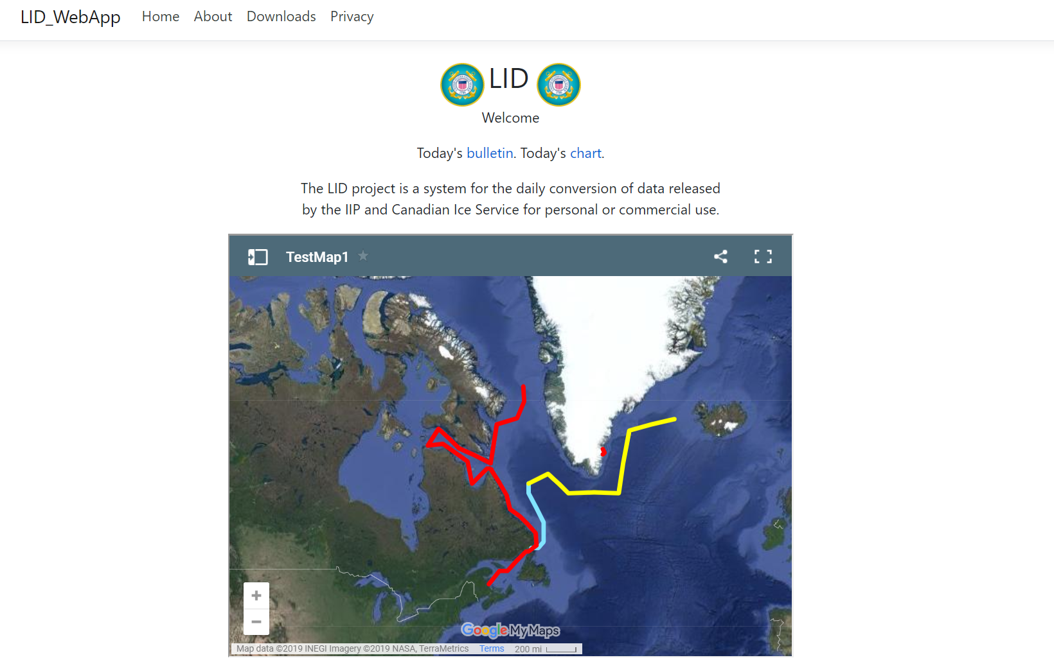
The Website
https://Lidtesting.azurewebsites.net
Home page has links to original data as well as an embedded google map with our converted data
Downloads page for KML history and desktop application
Notes:
Tom

Slide 15
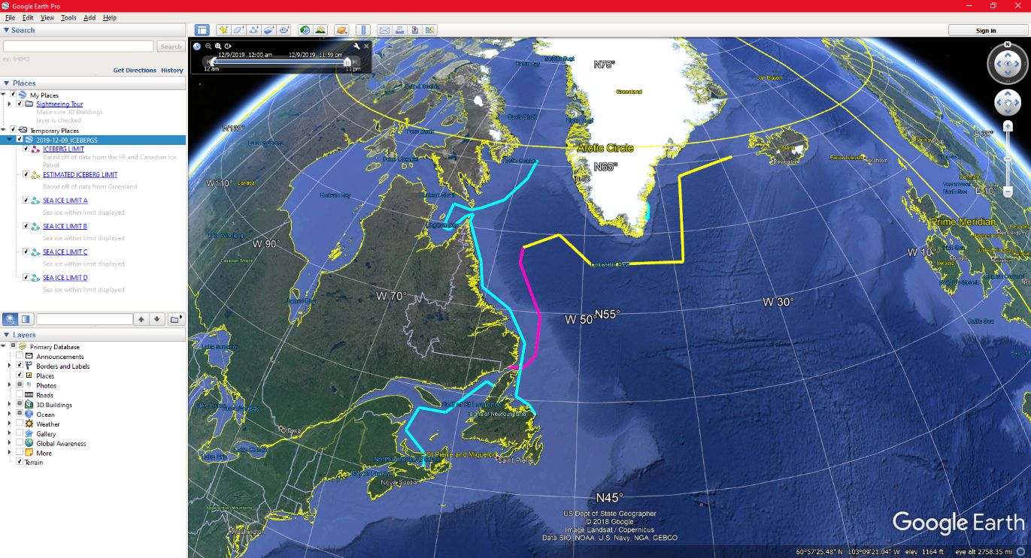
KML and Google Earth
A KML file is generated from the given data.
The KML file is used to generate the line display on Google Earth
Google Earth allows for a 3-dimensional display of the Iceberg limit
Notes:
Hayden

Slide 16
Definition of Ready
Creating updated KML files for website delivery and personal use
Creating AIS Messages that can be displayed on commercial equipment
Notes:
Luke

Slide 17
Follow-up Project(s)
Further development of a website that anyone can visit and see the current iceberg limit, ability to search and download KML and iceberg bulletin history
Develop autonomous delivery system for each day at the time that the bulletin is released
Testing on other commercial navigation devices beyond TV32
Notes:
Tom

Slide 18
Summary
The task was to enhance an already existing process, the dissemination of information for the safety of mariners
We produced a desktop application that pulls the data when used and outputs a KML file for use in Google Earth, and AIS Messages which can be input to navigation software
We also produced a proof of concept website which would display daily information and store historical data which would be publicly available
This project could continue with the further development of a web application, autonomous deployment of data, and testing with other navigational devices and software
Notes:
Hayden

Slide 19
Questions?
Notes:
Hayden

